Slide 1

From Observability to Supervised Autonomous Operations
Strategic Analysis of Dynatrace Perform 2026 (Based on IDC Report #IcUS54307526)

Slide 2

IT complexity forces a rethinking of digital system governance
Insight Generation (Past) Legacy tools focused on monitoring and analytics.
Orchestrated Action (Future)
Agentic Al and LLM-based applications demand supervised autonomous operations to scale and govern effectively.

Slide 3

The Trust Gap in Agentic AI
Non-determinism
Unpredictable behaviors and rapid architectural changes.
Dynamic cloud-native architectures introduce operating modes that traditional monitoring cannot address.
Hallucinations
Opaque decision-making eroding enterprise trust.
Runaway Costs
Unchecked LLM token consumption in production environments.

Slide 4

Rejecting “full autonomy now" in favor of supervised operations
Human augmentation and increased productivity, not labor replacement.
Humans act as goal-setters, describers, and supervisors.
Enforces real-time operational guardrails.
Creates a clear roadmap from reactive to preventive, and eventually autonomous operations.
Core Al System
Human Supervision
& Guardrails
Operational Context
& Roadmap

Slide 5

Dynatrace Intelligence acts as an agentic operations system
Moving beyond incremental Al features to a fleet of specialized, collaborative agents.
SRE Agent
DevOps Agent
Security Agent
Assist Agent

Slide 6

Deterministic AI prioritizes correctness over novelty
Core Mechanism: Combining the Grail data lakehouse with the Smartscape real-time causal dependency graph.
Business Impacts
Provides a traceable "chain of thought" for Al decisions.
Reduces the need to repeatedly invoke LLMs.
Lowers token consumption and accelerates Root Cause Analysis (RCA).
Probabilistic LLMs
Deterministic Al

Slide 7
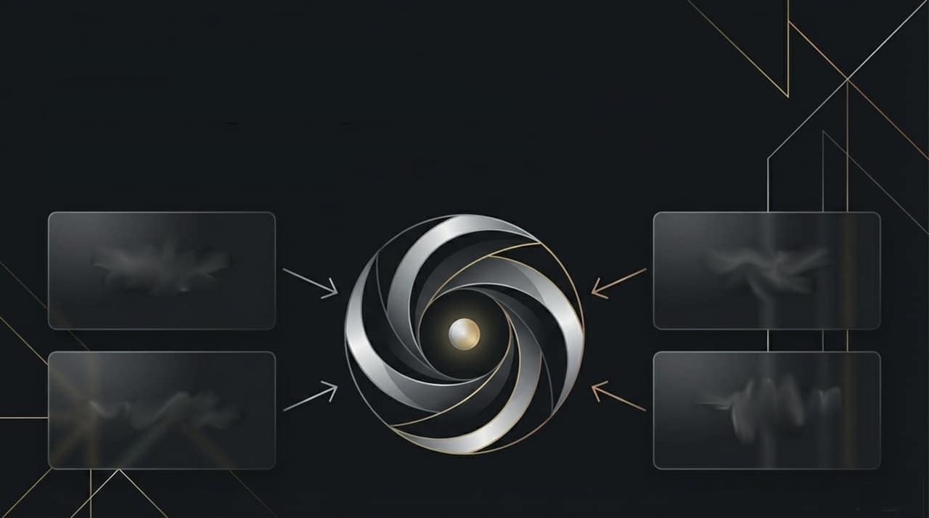
"The AI that observes AI' secures the path to production
Moving the platform to a control plane for Al governance, rather than just a productivity layer.
Model version comparison
Hallucination detection
Cost forecasting
Agent decision tracing

Slide 8

Unified data is the prerequisite for tool consolidation
Traces
User Sessions
Metrics
Automating fragmented systems is impossible. Dynatrace Grail underpins the entire ecosystem.
Metrics, logs, traces, user sessions, and business events live in a single unified data model.
Exponentially faster decision-making for complex questions generated by Al-driven systems.
Logs
Business Events
Grail data lakehouse
Notes:
Metrics Grail datahouse

Slide 9

Security operates inside the causal dependency graph
Core Concept: Security is embedded in Grail natively alongside business and observability data
Key Features:
Runtime vulnerability analytics and runtime application protection.
Strategic Value:
Autonomous workflows operate with a complete picture of security risk, directly informing agentic decision-making.

Slide 10

Empowering developers and platform engineering teams
Key Capabilities:
IDE-native insights and live debugging.
Backstage integration.
Feature flag management and progressive delivery via DevCycle integration.
Influencing the software delivery lifecycle long before production operations.
Impact
Platform teams emerge as key influencers for observability tooling.

Slide 11

Visibility into modern architectures and seamless ecosystem expansion
Next-Gen RUM
MCP Server
Real User Monitoring upgraded for Single-Page Apps (SPAs) and asynchronous rendering.
Governed interface (GA since May 2025) for Claude, AWS Bedrock, and Azure Al Foundry.
Cloud SPs
ServiceNow
AWS DevOps Agent, Azure SRE Agent, and Gemini CLI Extension.
Deepened partnership for platform-to-platform closed-loop, self-healing systems.

Slide 12

Translating technical telemetry into measurable business outcomes
Operational Efficiency
Customer Experience
Business Growth
Drastic MTTR reductions and availability improvements.
Increased customer satisfaction rates and Net Promoter Scores (NPS).
Accelerated time to market and tangible revenue growth.

Slide 13

Actionable recommendations for
navigating agentic operations
Transition from 'blind' deployment to tracking token consumption, response times, and agentic supply chains.
Inject Al observability into all Al use cases to ensure transparency, reduce risk, and improve ROI.
Evaluate Al monetization strategies and their implications for platform expansion and data requirements.
Understand the change management required to adopt an Al agent architecture.

Slide 14

Core strategic takeaways
Observability is now a platform for supervised autonomous operations, balancing innovation with enterprise control
Deterministic Al builds required trust and controls costs through causal context.
Al Observability is a critical necessity as LLM applications scale into production
Unified data and developer experience are central to tool consolidation and rapid decision-making.

Slide 15

AI and business observability are foundational ingredients for driving sustainable, scalable results across all AI-led use cases.
Based on IDC Analysis: 'Dynatrace Perform 2026: From Observability to Supervised Autonomous Operations' (Document #IcUS54307526).

